Slide 1
Solving a Russian Grammar Error with NLP
Prepared by Nooshin Pourkamali
Professor: Dr. Zahraii

Slide 2
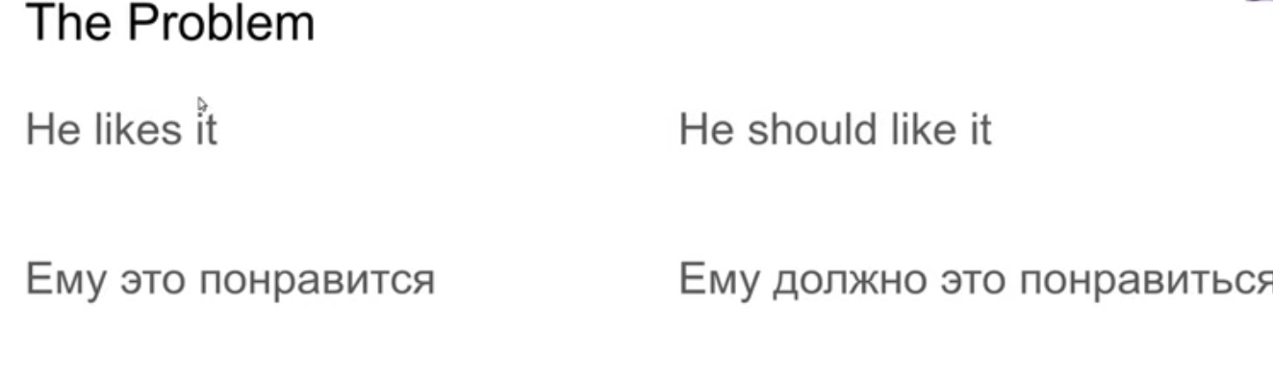
Finite
infinite
Because the pronounciation is the same thing some language models don’t t distinct them, which is one of the most whidespread and irritating grammar errors with Russian language in machine Translation

Slide 3
So, What is the state of the art to control this and other grammar error in Russian language?
MS word model/Algorithm can catch that, in a paid version of the software
For the English we have Grammarly and for the German language for example we have two startups that are already compatible as German Versions of Grammarly
What is a language model?
Long story short, A language model gives data as input, and predit the rest of it based on the patterns on the data received. Different patterns result different language models

Slide 4
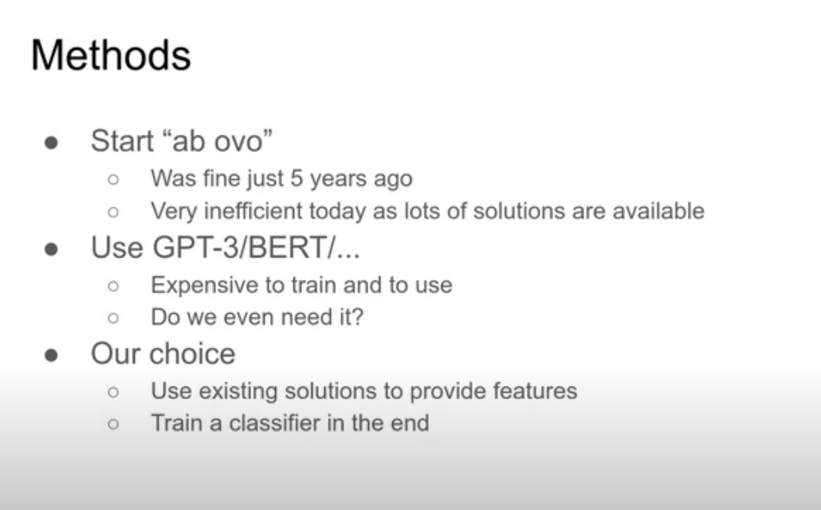

Word2vec, bags of words, etc…
The first model was Bert by Google, the most recent one is GPT-3, which is the one Microsoft also has it for Russian, while the English versio is not useable for case studies.
For educational matters you can have access to this model asa open source model.
The problems with gp3: 1. needs a cloud for a reasonable speed 2. expensive to train
So the choice here is to not to train data but use the deep learning solutions available
Having a rich dataset helps us avoid this gramatical mistake, and at the end we train a classifier to recognize wether the mistake was made or avoided.

Slide 5
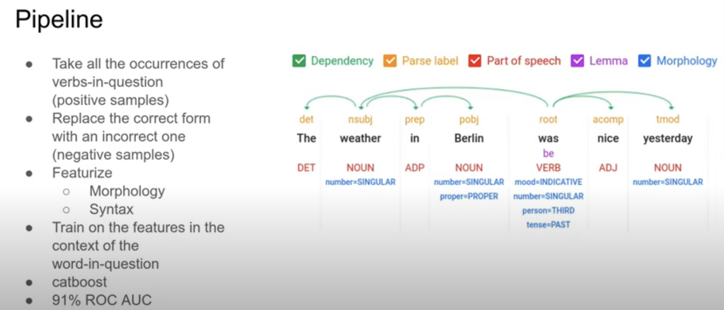
CatBoost is a high-performance, open-source library for gradient boosting on decision trees. From release 0.19. 1, it supports text features for classification on GPU out-of-the-box. The main advantage is that CatBoost can include categorical functions and text functions in your data without additional preprocessing.
Source: Google cloud NLP solutions
We use these features of the sentence words in order to use them as our input for the prediction result desired.

Slide 6
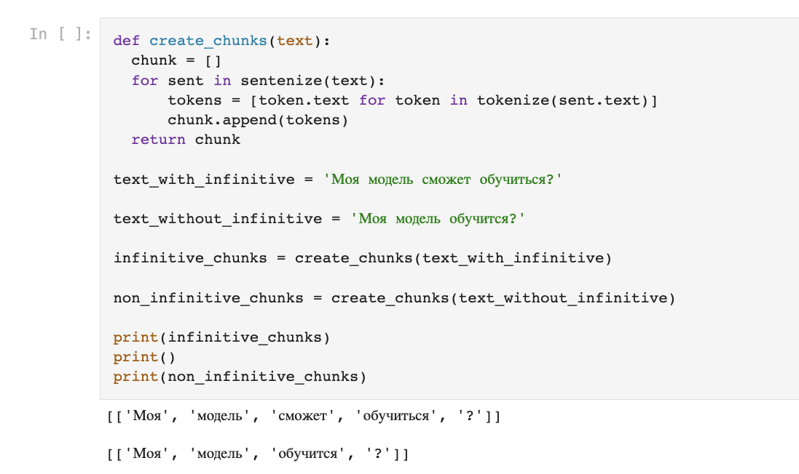

Slide 7
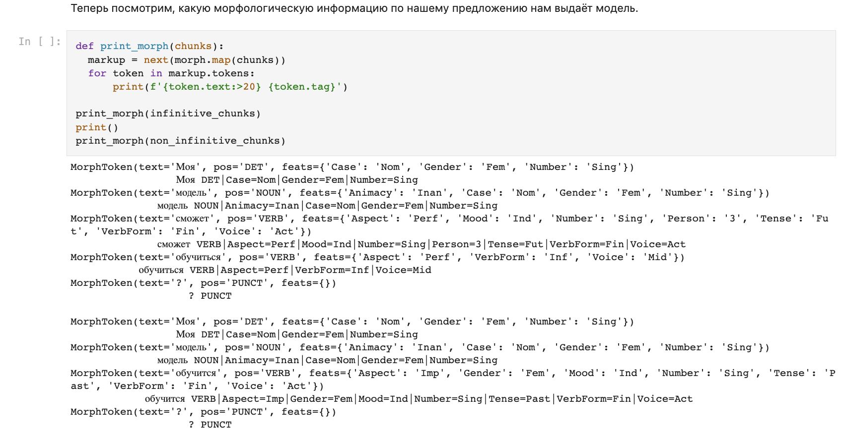

Slide 8
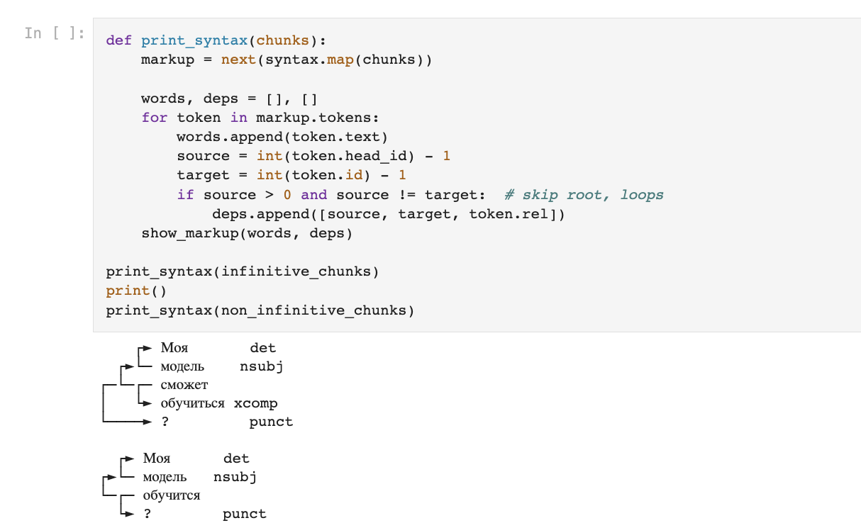

Slide 9
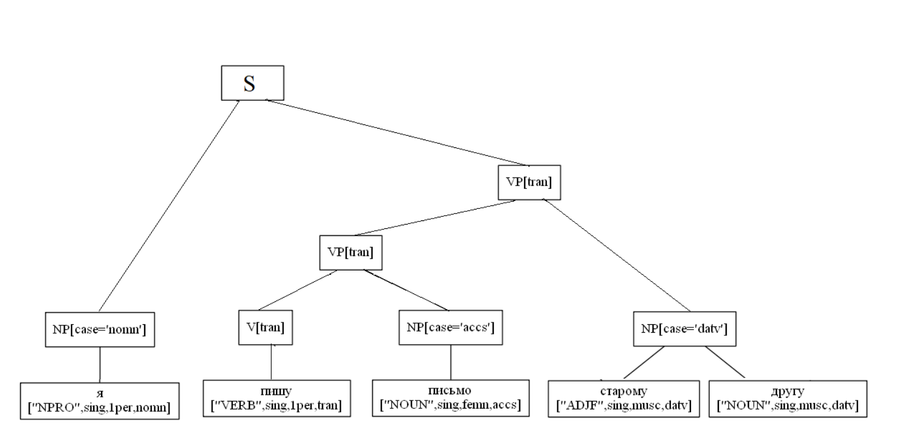
1. Разбиение предложения на синтаксические единицы
2. Определение грамматических параметров (граммем)
Граммемой называется элемент грамматической категории; различные граммемы одной категории исключают друг друга и не могут быть выражены вместе. Для каждой словоформы определяем набор из семи граммем: [ ЧАСТЬ РЕЧИ, ЧИСЛО, ЛИЦО, РОД, ПАДЕЖ, ВАЛЕНТНОСТЬ, ВРЕМЯ ]
3. Определение синтаксической связи между словами
Для описания русского языка будем использовать теорию грамматики составляющих (phrase structure grammar), которая утверждает что всякая сложная грамматическая единица складывается из двух более простых и не пересекающихся единиц, называемых её непосредственными составляющими. Выделяют следующие составляющие:
Именная группа (NP)
Глагольная группа (VP)
Предложная группа (PP)
(4) Полное предложение (S)

Slide 10
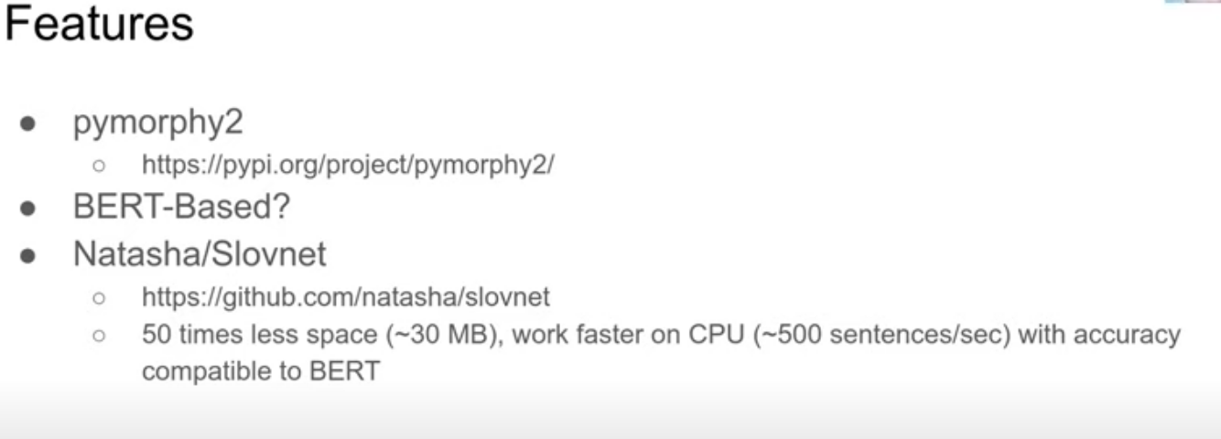
Choosing tools is language specific
Morphological analyser with great dictionaries as data sets
For grammar errors we need grammar trees, and building them is hard. Bert model is the most recent successful attempt, converting the text into a gramatical tree, and then converting it to the assembely language as the machine language. It also comes for many languages
Disadvantages of Bert: it needs version languages, a docker container to allow it to communicate with api, which is not fast, also Bert is huge.
For Russian language theres a solution to aviod these problem Slovnet, language entity recognition on a very highlevel wich is specifically designed for Russain Language, so its faster not that heavy with the same accuracy

Slide 11
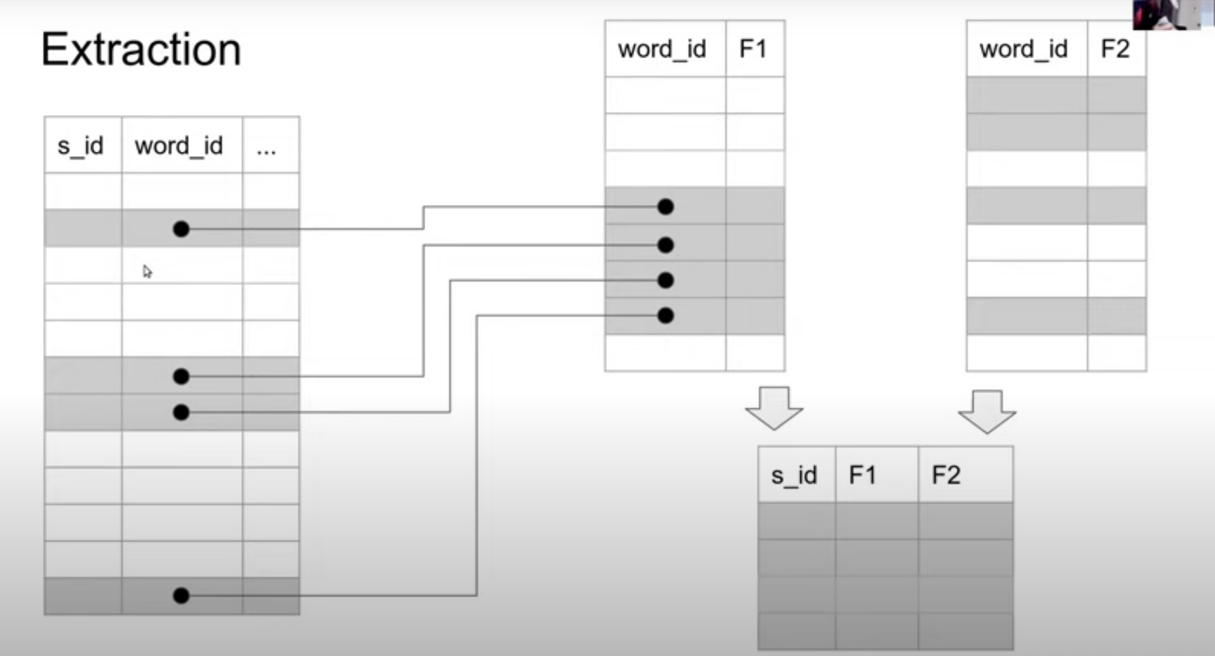
Features of every single word needs to be compared with its context in separate table and then emerge them to one. Technically it is impossible especially for long texts.
So we need the model training. An example of the problems may occur are in the next slide:

Slide 12
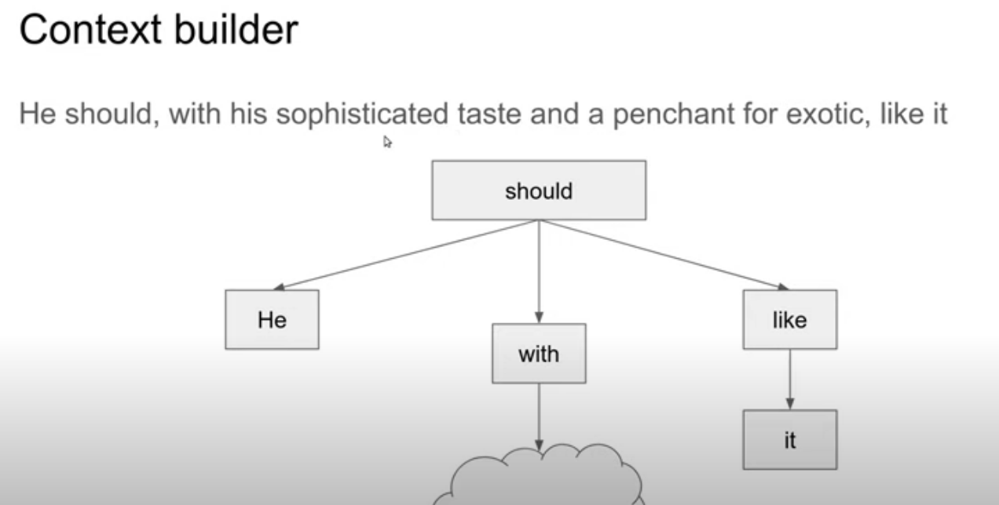

Like it
Wrong place in English but true in Russian
It can be in any place in Russain
Ему должно понравиться с его утонченным вкусом
He should like it with his sophisticated taste

